Slide 1
Specialized database project
Learning Team C – Week Five
Adam Schmitt, Elbio Iseas, Neil Goldstein
September 19, 2016
Faculty – Devin Dickens

Slide 2
Introduction
This Team was asked to create an Inventory Price Tracking Database, and for that reason the Team will create the table PriceHistory to store the inventory of the company parts and to with the intention of keep track of prices and their dates.
In future stages of the project the database will change to comply with requirements by adding spatial components and to use a format of interchange data with the database given with the eXtensible Markup Language known as XML.

Slide 3
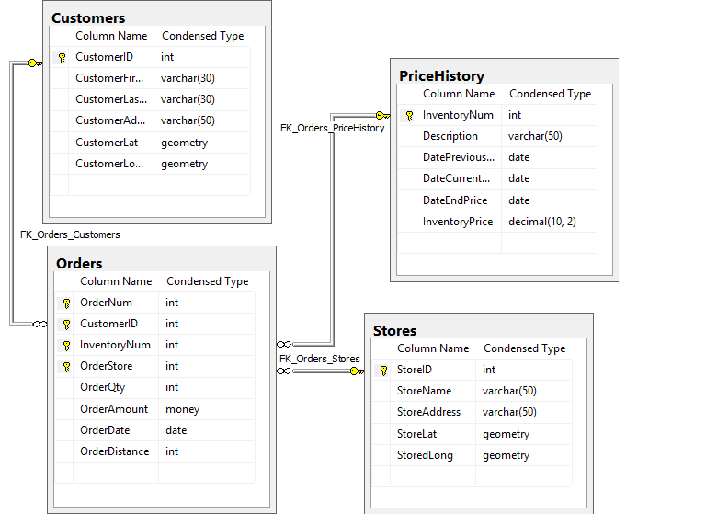
Database ERDs

Slide 4
Explanation of the Database ERD
This database uses four tables in a Star Schema with one Fact table Orders and three Dimension tables:
Stores
PriceHistory
Customers and Stores tables contain spatial attributes geometry for latitude and longitude, and Orders the distance from the Customer’s address to the Store of shipping.

Slide 5
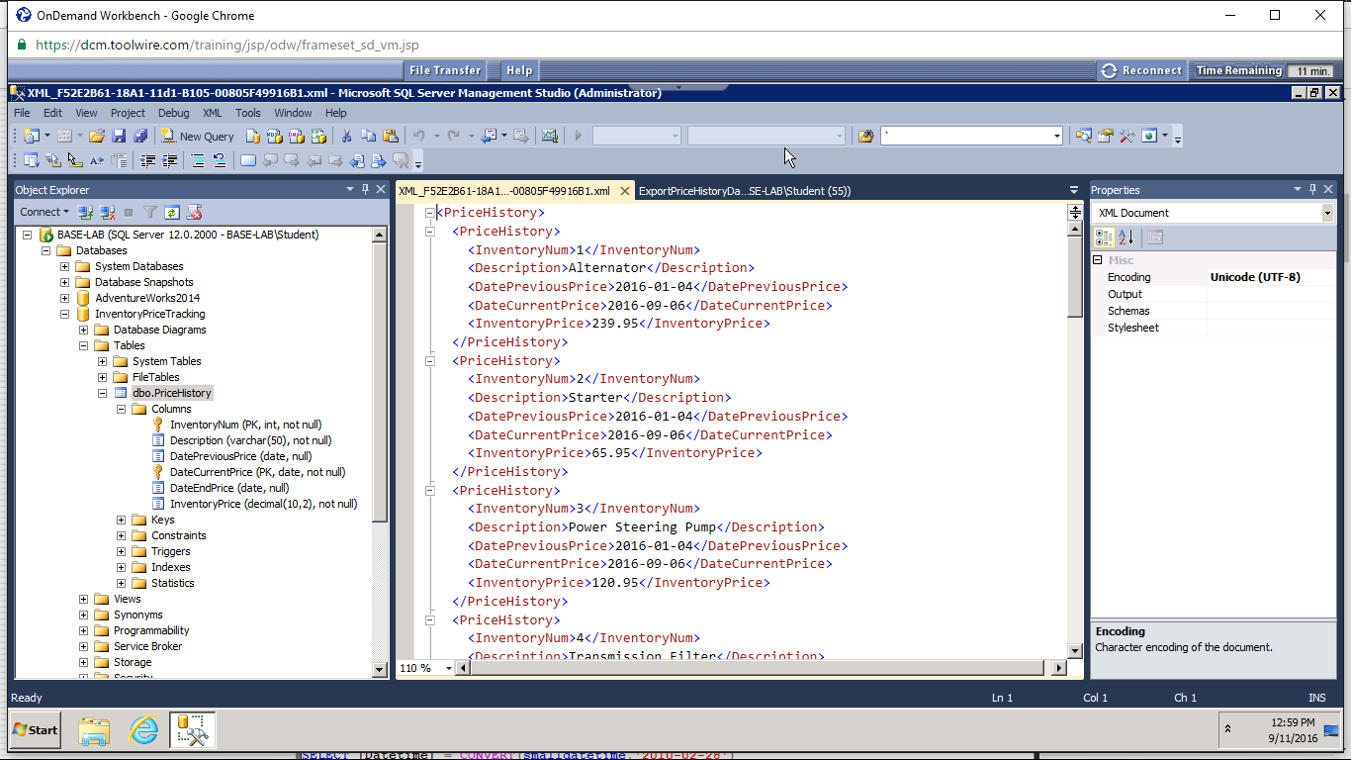
Screen shot of XML file created from SQL Table

Slide 6
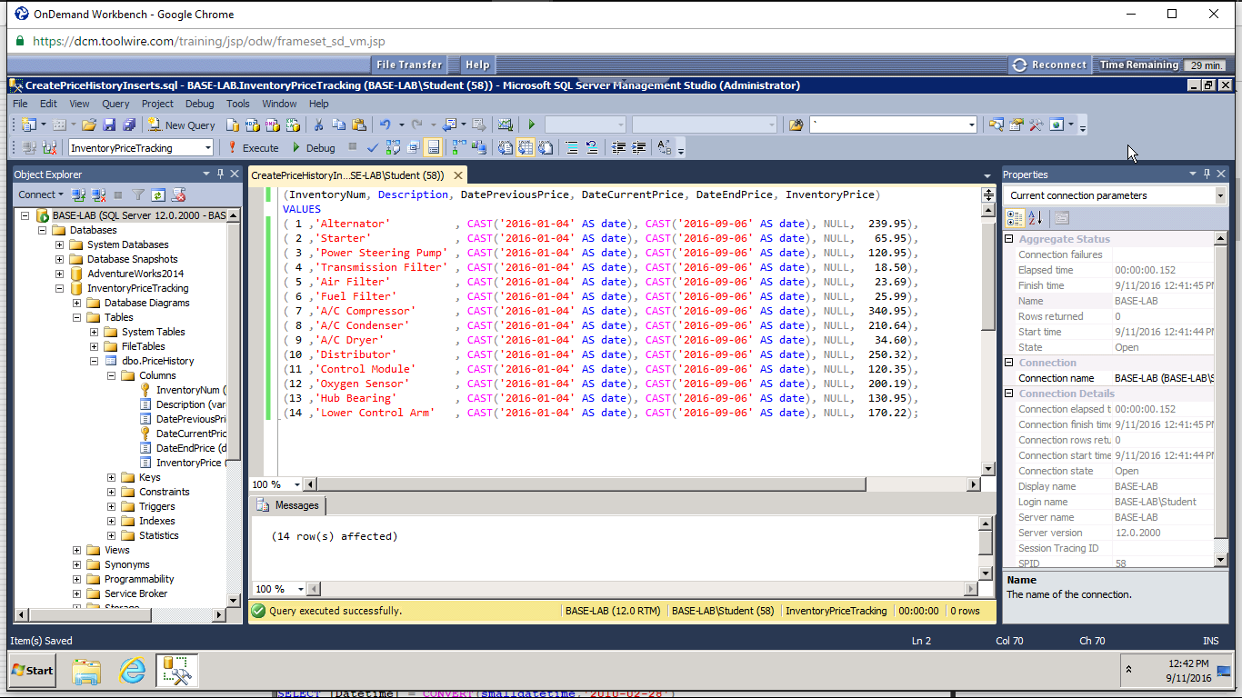
Inserts to the PriceHistory Table

Slide 7
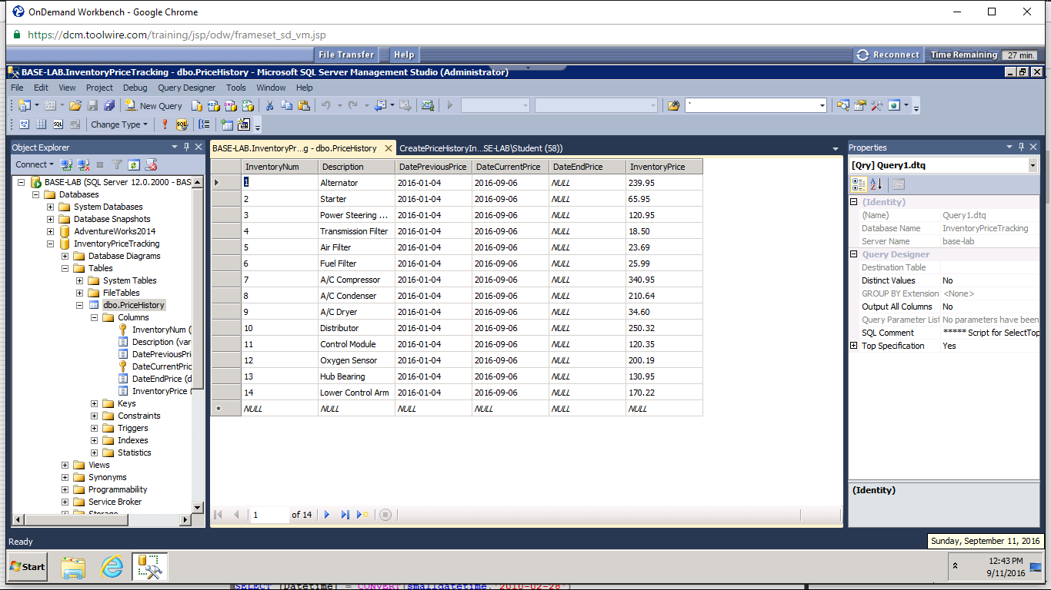
Data inserted in table PriceHistory

Slide 8
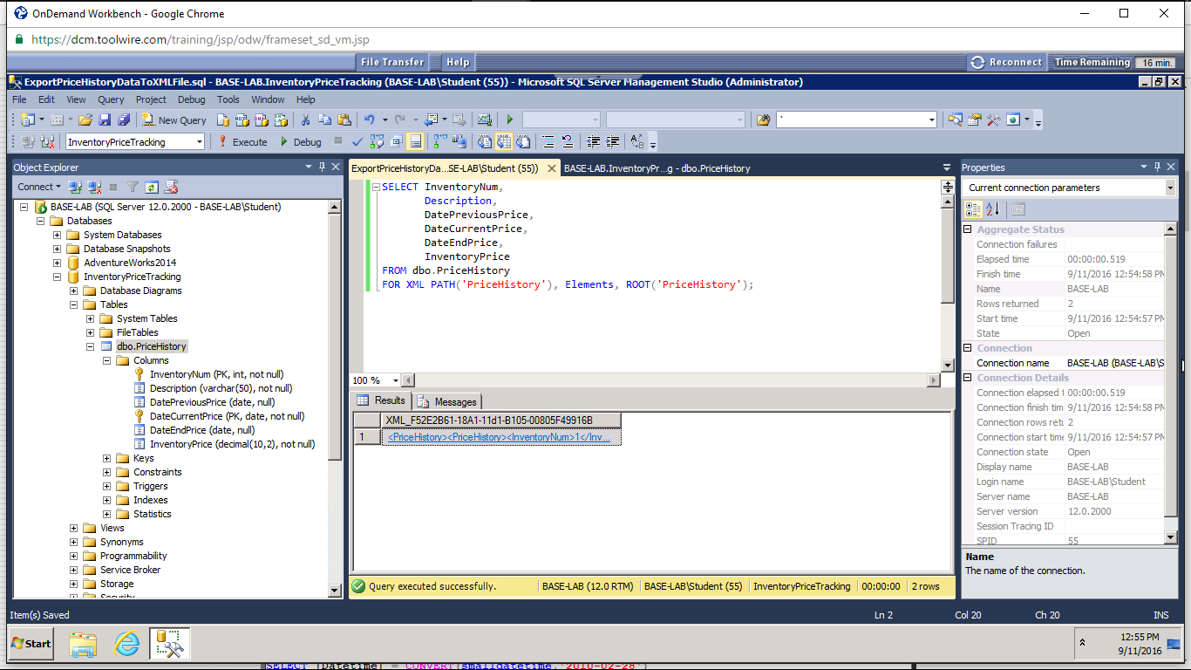
Exporting from SQL to XML file

Slide 9
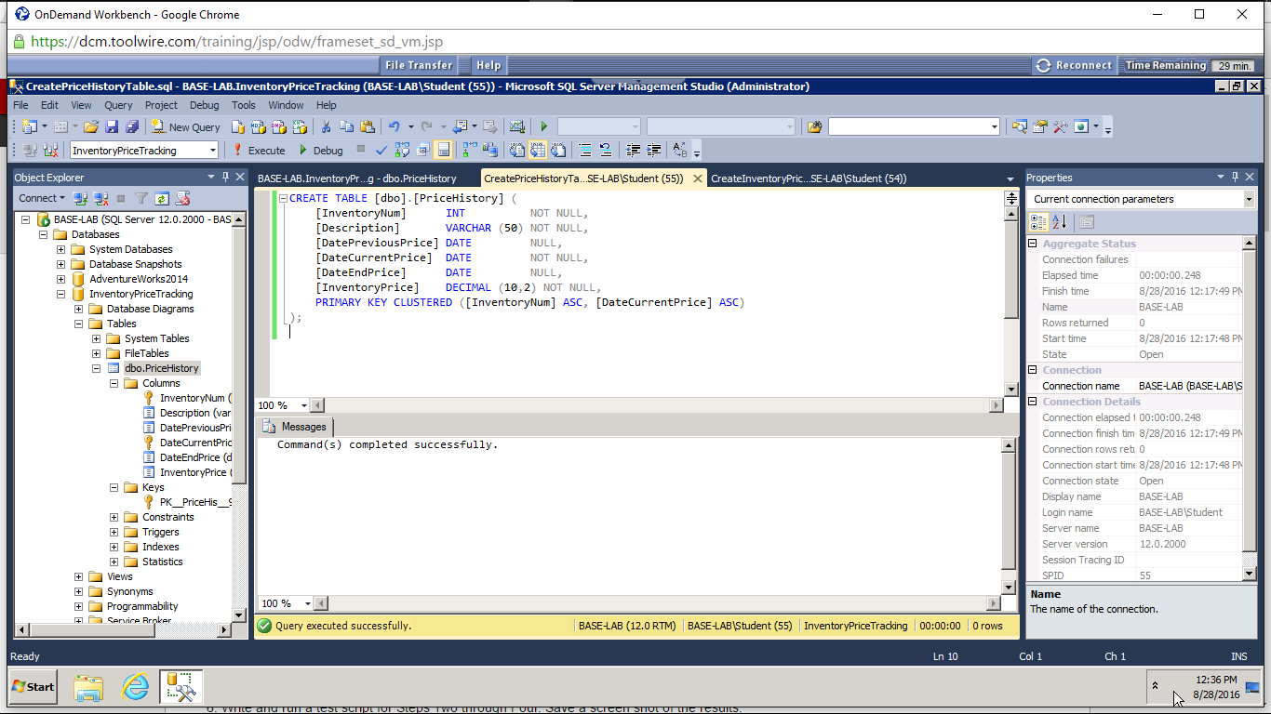
Room for Improvement
Adequate design
Character limits sufficient
Concise

Slide 10
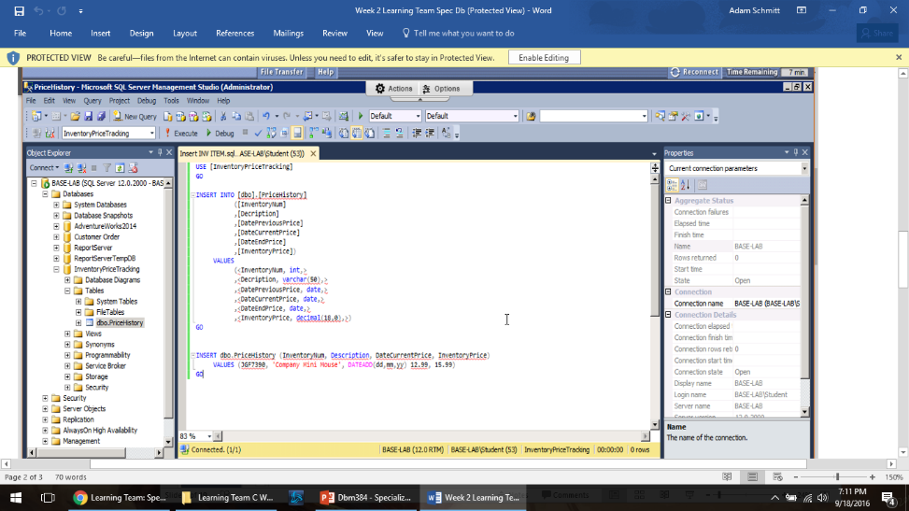
Room for Improvement
DDL Status: Good
DML Status: Fair
Assessment: Needs improvement
Notes:
The script shown does an adequate job as far as creating the tables, therefore barring any kind of additional need, can remain as they are. However, there is a slight modification that part of the DML script that is needed to function. The insert statement as is, inserts text values into the table, but not any actual data values. The script should read “INSERT into datefield values ‘9/1/2016’ for example. That way, there is data actually going into the database and not just a designation of columns. but your insert statement just inserts "text" values into the table and does not actually insert values of the data. This script should say something like insert into datefield values '9/1/2016'

Slide 11
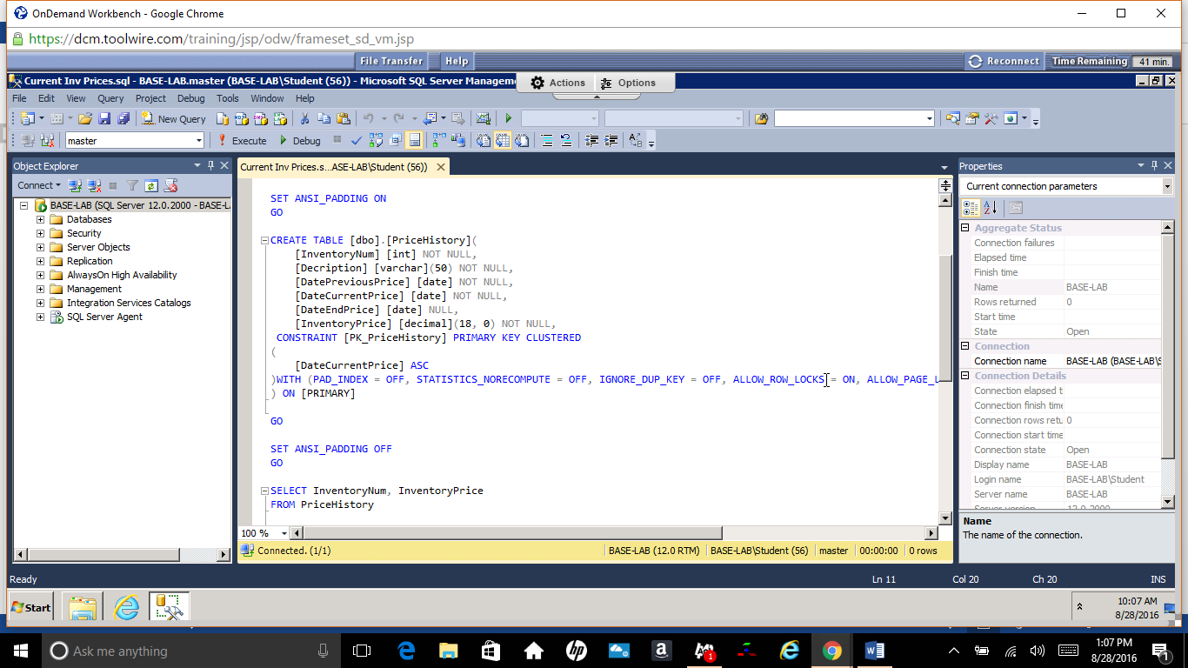
Room for Improvement
Select function works as intended
Table creation language functions

Slide 12

Room for Improvement
Is This The Best Design?
Should use one location field with data type: geography
Notes:
The basic layout is good, but locational data types could be better if we were to use the spatial features of SQL Server 2014, as well as adding some additional fields to support data mining later.

Slide 13
Room for Improvement
Is This The Best Design?
Missing State and Zipcode which can be very useful in Business Intelligence analysis later
Notes:
Adding more information about the customers location with respect to address and phone databases would be a great addition to any data mining activities.

Slide 14
Room for Improvement
Are the spatial components working?
They will work this way, but having the proper, single data type would work better
Notes:
The field type geography is best used for relating spatial data, both locational, or shape related. The data is stored in a binary string, so it must be converted back into Lat and Long values with a function when retrieved. This would all be more efficient than what we originally did here with separate Lat and Long values.

Slide 15
Room for Improvement
How would you change the design?
For the customers, I would use a lat-long lookup service to get the contents of the geography value. For the stores, a fixed value for the geography value. Having one field for location is more reliable and more efficient.
Notes:
Using an online lookup service would get a very accurate locational value, as corrections are sometimes made to these databases as errors are found.

Slide 16
Room for Improvement
Overall, this is not a bad design if you replace the Spatial fields with single geography-type fields. Running distance queries on this design with respect to customers and stores would help to consider where to locate more stores in the future.
Notes:
Using an online lookup service would get a very accurate locational value, as corrections are sometimes made to these databases as errors are found.

Slide 17
Conclusion
The use the DBMS SQL Server 2014 meets the features required to manage and report intelligence to the company to make the right decisions about business.

